Slide 1
Helmet Detection AI
Team 53 - Ishan, Aarnav and Aditya

Slide 2
Introduction: Road Safety in India: A Critical Concern
The Current Scenario:
India faces a critical challenge concerning road safety, with a significant number of accidents and injuries occurring daily.
Two-wheeler riders constitute a substantial portion of road users, making it imperative to address safety measures for this demographic.
The Importance of Helmet Usage:
Helmet usage plays a pivotal role in reducing the severity of injuries and fatalities in two-wheeler accidents.
Despite awareness campaigns, non-compliance with helmet regulations remains a persistent issue.

Slide 3

Problems
Road Safety Challenges in India
Challenges in Enforcing Helmet Usage
Need for a Low-Tech Technological Solution

Slide 4
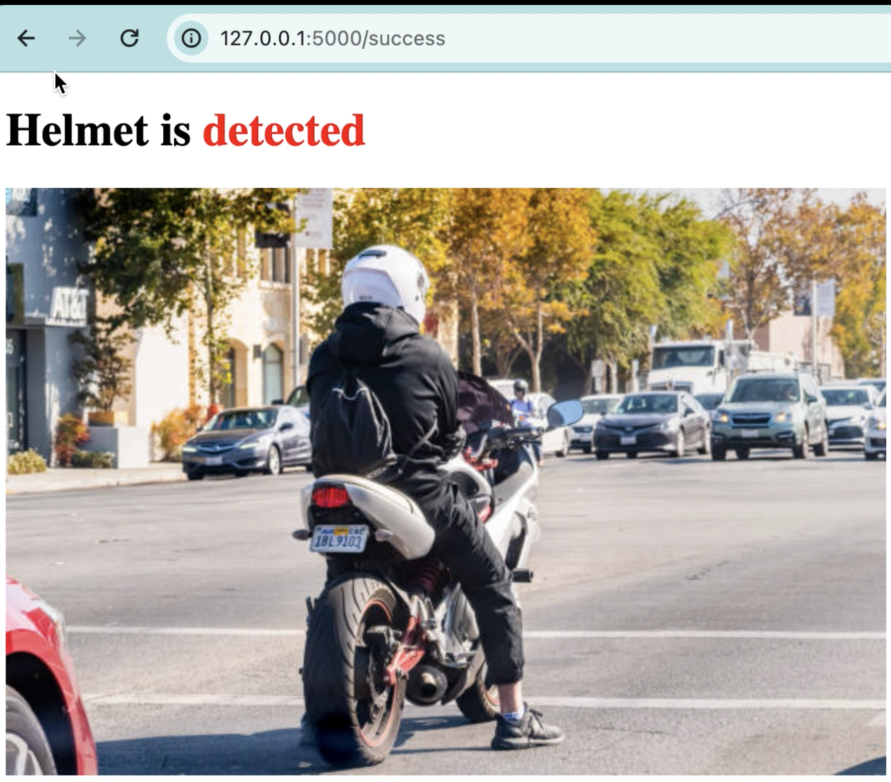
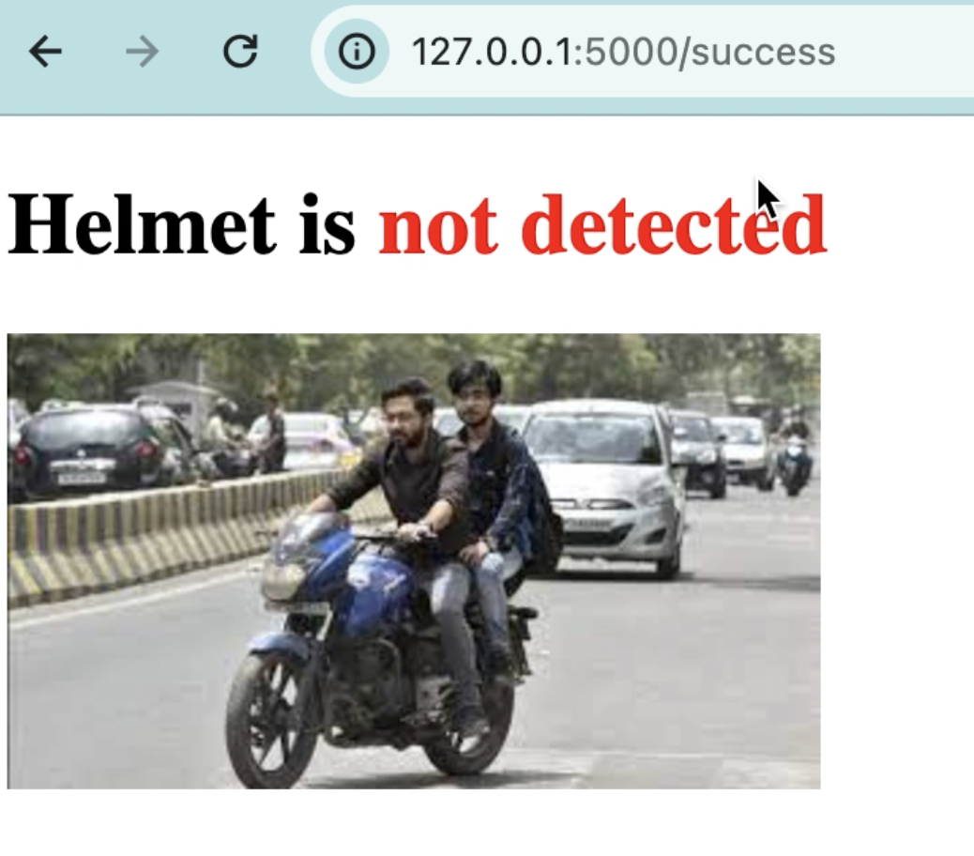
Our Ideas

Slide 5
Our Unique Selling Proposition (USP)
Unprecedented Accuracy:
Exceptional accuracy of our algorithm in detecting helmets, ensuring reliable and trustworthy results.
We are able to achieve this as our Code utilizes the ‘REKOGNITION API’ created by AWS to detect Objects in an Image and assign labels to it
Traditional methods only utilize
Real-time Monitoring Capability: (Part of Original Ideas)
Showcase the real-time monitoring feature, allowing immediate intervention and feedback for non-compliance.
Position our solution as proactive and responsive to ensure road safety.

Slide 6
Problems Faced During Coding
Our idea was to use a “Raspberry Pi” and camera to take LIVE feed. Build a one of our systems as a server and host a Website using Flask and use Socket Protocol in Python. We ran out of time.
This website would have allowed us to interact with the raspberry pi and show Pibrella lights as “Traffic Lights”
SSH protocol and port access was blocked in the school network
We ran SSH Daemon on a different port but protocol was disallowed.

